Slide 1
Tight labor market, rising wages, and the great stabilization
Consensus Economic Forecasting Commission
October 27, 2017
Glenn Mills
Chief Economist
Center for Workforce Research
Maine Dept. of Labor
www.maine.gov/labor/cwri
Glenn.mills@maine.gov
207-621-5192

Slide 2
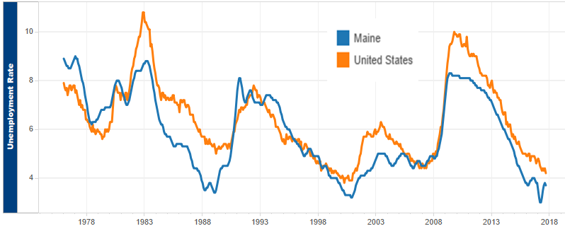
Unemployment remains historically low, at or below 4% for 24 months through September

Slide 3
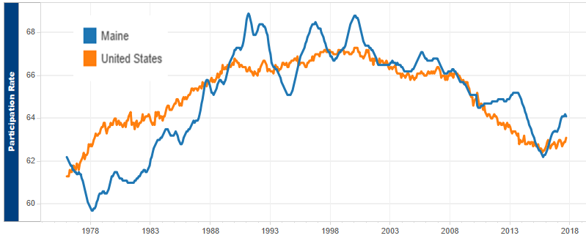
The cyclical effects from the downturn on labor force participation are mostly over; the structural effects of an advancing population age structure will limit the rise

Slide 4
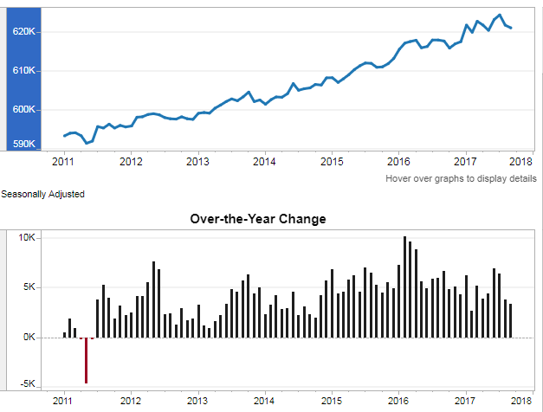
Payroll job growth continues, though it has slowed since unemployment reached very low rates

Slide 5
Job growth since 2000 has been historically low, reflecting the lack of young people aging into the workforce

Slide 6
In the 1990s most job growth was in healthcare and professional & business services, offsetting manufacturing declines

Slide 7
In the 2000s growth in healthcare slowed and manufacturing declines accelerated

Slide 8
This decade has been the great stabilization in most sectors, including manufacturing for the first time in four decades. We largely expect this trend to continue for the next several years.

Slide 9
A record $26.4 billion in wages were paid in the year through June

Slide 10
Inflation-adjusted wages are up sharply to an average of $43,500 per job in the year through June

